Slide 1
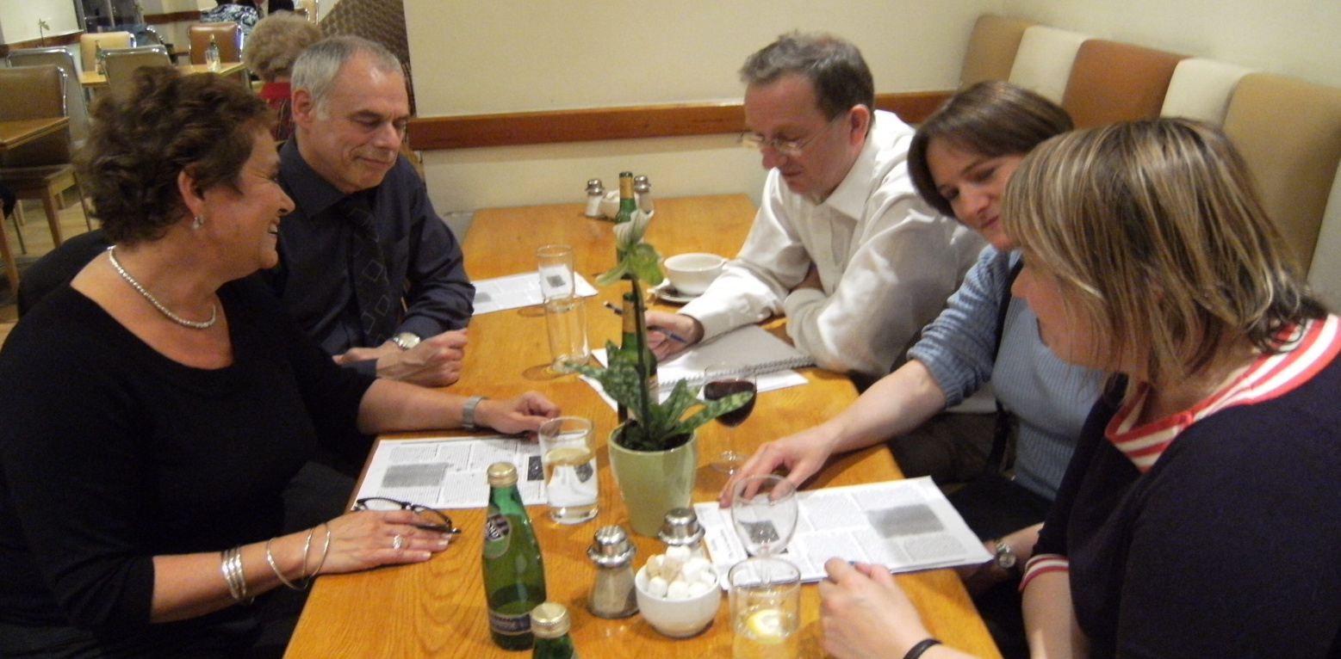
Learning to teach
The influence of science on education research
Dr Andrew Morris
President, British Science Association (Education Section)
Chair Coalition for Evidence-Based Education
Hon. Senior Lecturer, UCL Institute of Education

Slide 2
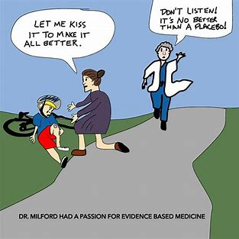

Slide 3
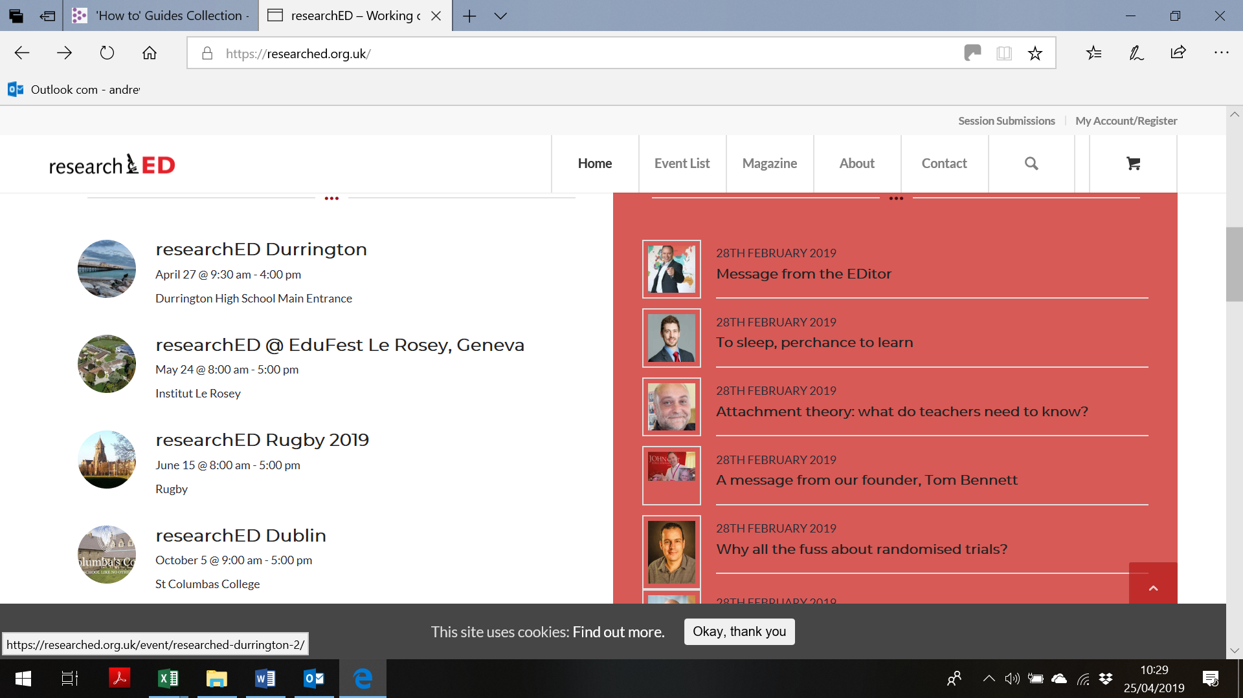

Slide 4

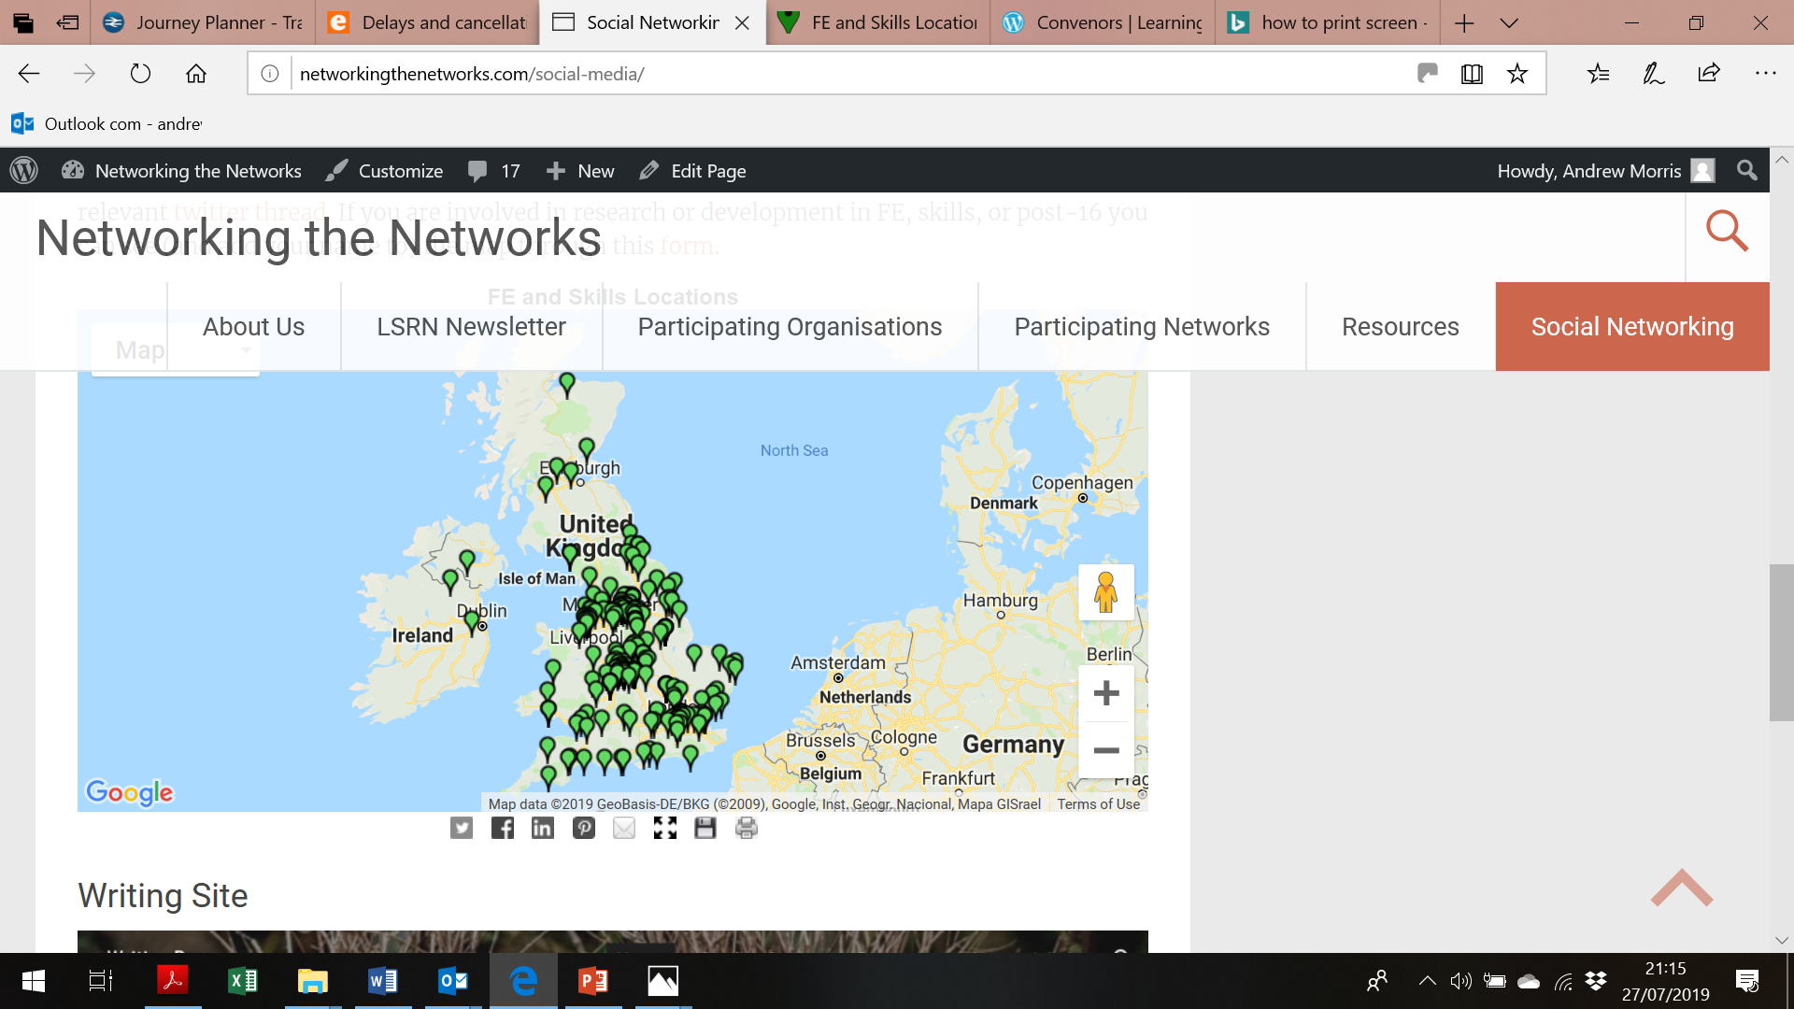

Slide 5
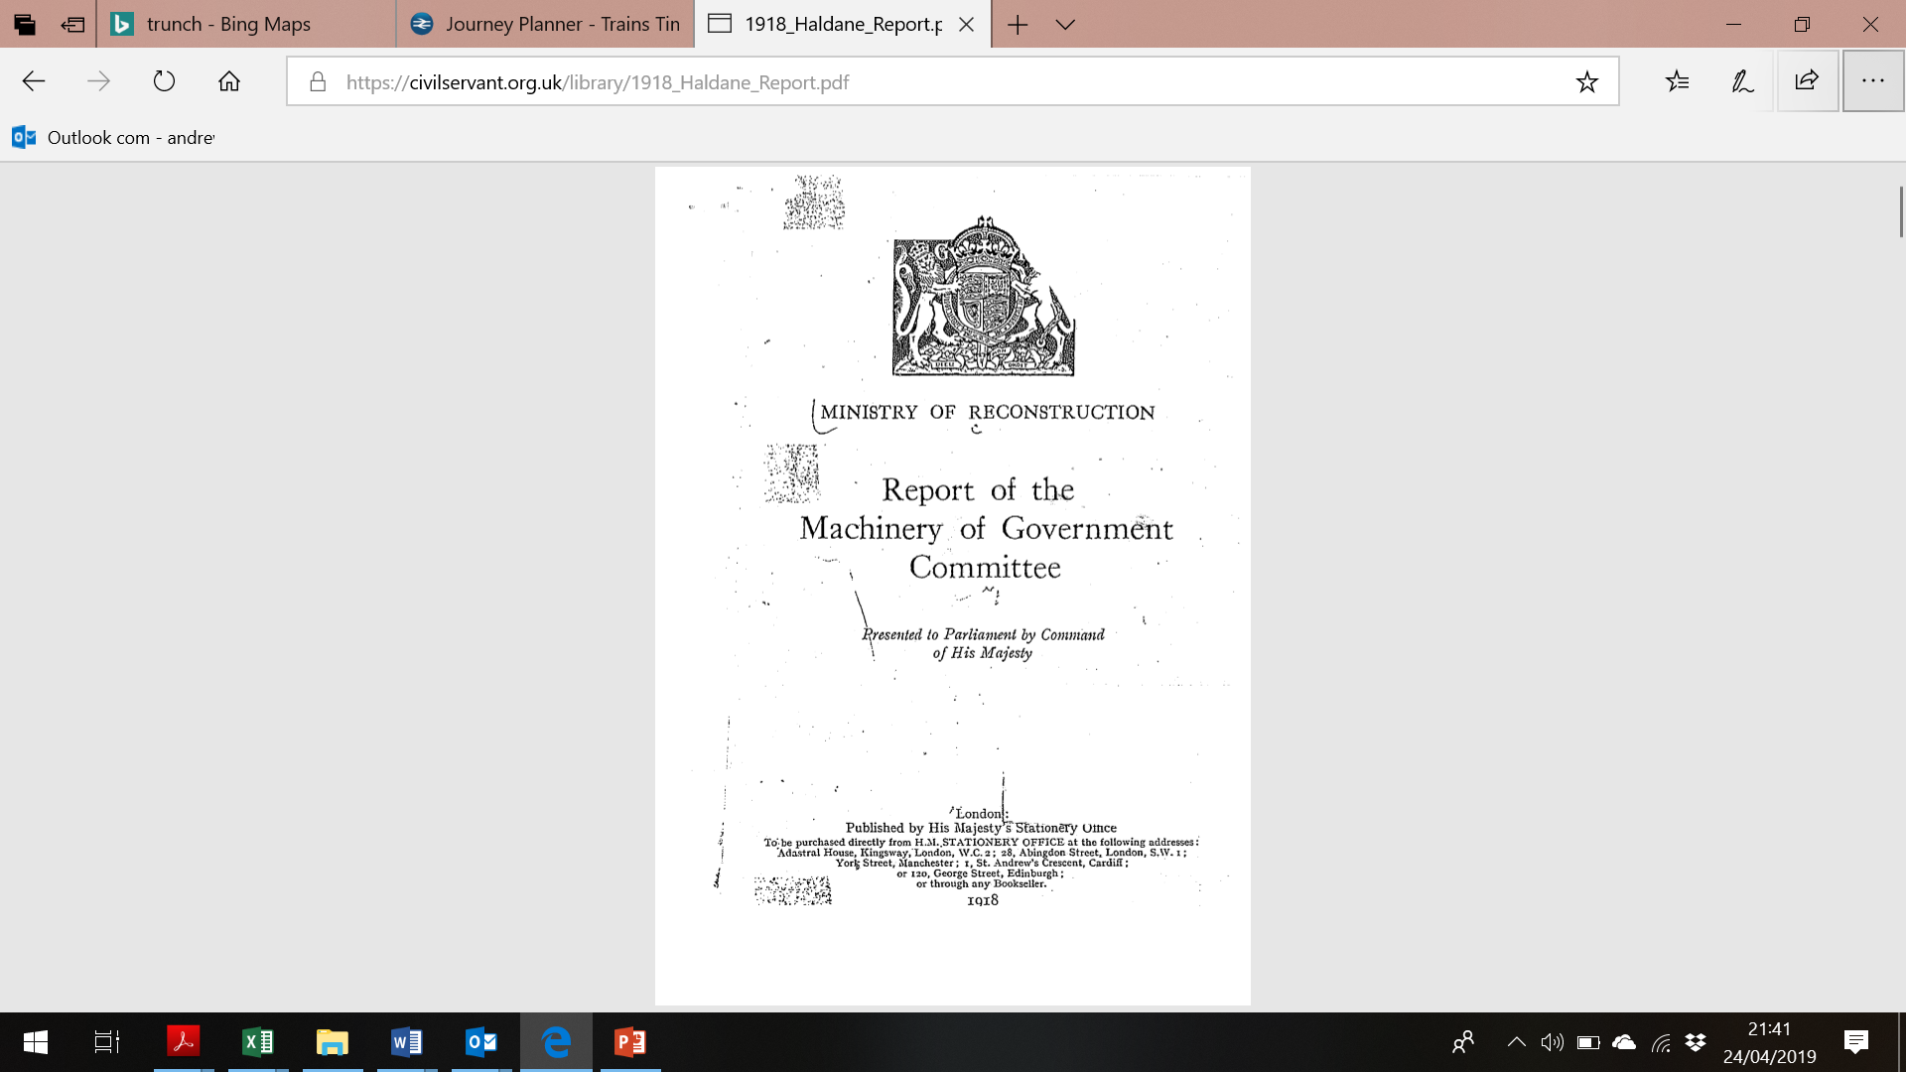

Slide 6


Slide 7


Working Paper 9.2
Final Report of the
National Educational Research Forum
Andrew Morris
Michael Peckham
March 2006

Slide 8


Slide 9


Slide 10


Slide 11



Slide 12
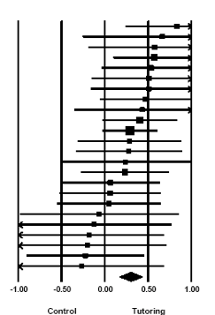
Forest Plot on volunteer tutoring the mean is smaller then we think/hope
(courtesy of Steve Higgins, Durham University)

Slide 13
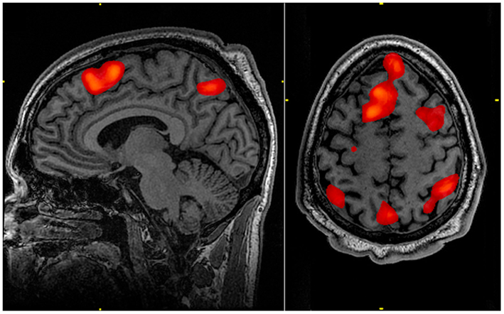
fMRI scan - working memory
https://commons.wikimedia.org/wiki/File:FMRI_scan_during_working_memory_tasks.jpg

Slide 14
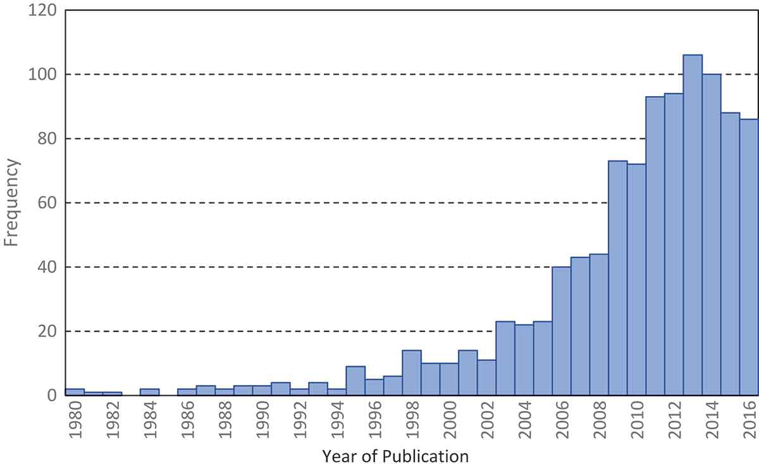
RCTs in education 1980 – 2016
(internationally)
Connolly P. et al. Educational Research Volume 60, 2018 - Issue 3:

Slide 15


Slide 16


Slide 17
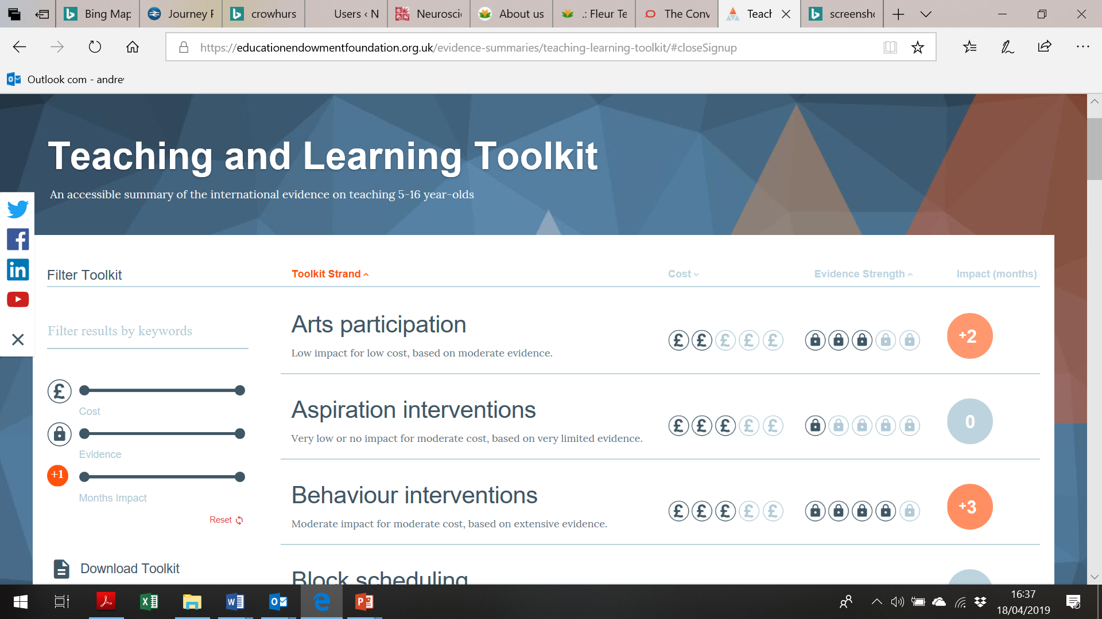

Slide 18


Slide 19
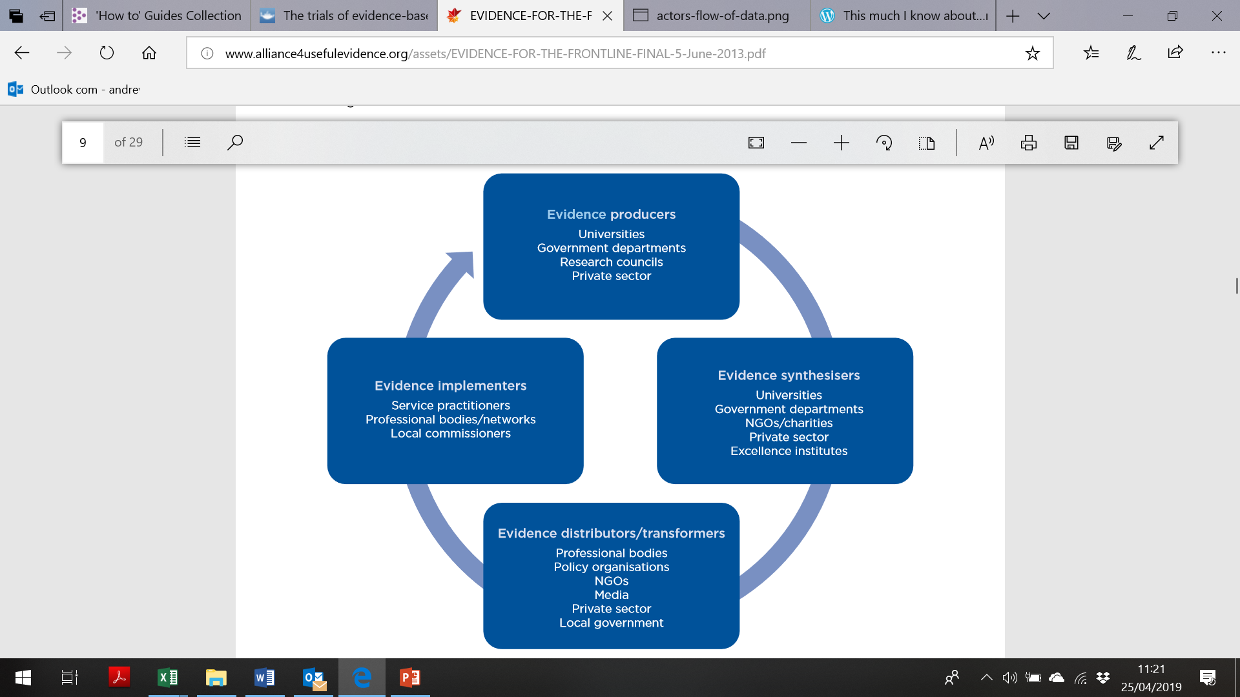

Slide 20
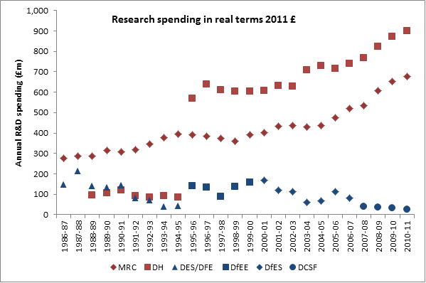
https://blogs.lse.ac.uk/politicsandpolicy/theres-no-such-thing-as-a-free-rct-a-response-to-goldacre-and-gove/

Slide 21
Multiplicity of disciplines
Sociology
    Effects of class on attainment
    Family contribution to attainment
Geography
    Location of vocational specialisms
    Catchment area
    Skills for regional development
Economics
    Returns to qualifications
    Contribution of, and demand for, skills
Statistics
    Longitudinal effects of disadvantage
    Effects of streaming
Psychology
    Influences on memory
    Motivation factors

Slide 22
Multiplicity of disciplines
Neuroscience
    Cognitive conflict in learning
    Spacing and interleaving learning
Information Technology
    Tracking performance
    Teaching complex/3D/animated concepts
Management
    Effective management approaches
    Systems design
    Recruiting and retaining staff
Architecture
    Flexible use of space
    Creating calm environment

Slide 23
Multiplicity of disciplines
Human biology
    Epidemiology e.g. early term births
    Cognitive effects of hormones, medication
Environmental science
    Cognitive and behavioural effects of pollution
    Effects of sport/outdoor activity
Other important disciplines
    History
    Philosophy
    Anthropology

Slide 24
And finally…
If you have been, thanks for listening
(after Glyn Worsnip)
Always happy to discuss these points:
Andrew Morris
a.j.morris@ucl.ac.uk

