Slide 1
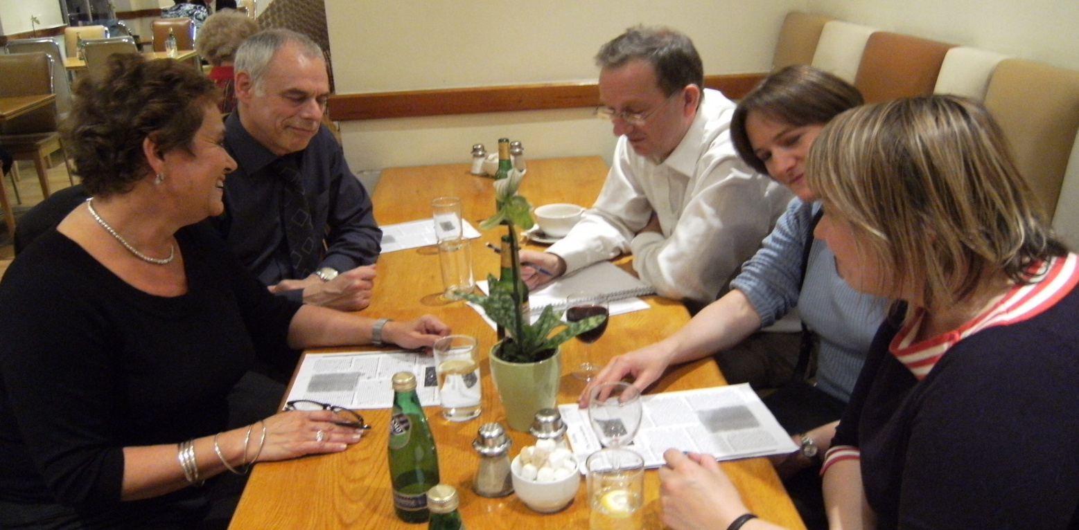
Science discussion groups
Look mum, no syllabus!

Slide 2
Points to discuss
What do you make of the observations?
Does it have anything to say about formal learning?

Slide 3
An alternative approach
Discussion format
  Start from questions/observations in everyday life
About ideas more than facts
  No maths, no labs
Based on belief that
  science ideas should be accessible, as for the humanities
  people are curious but intimidated by science
  prior concepts need to be expressed before new ones (Vygotsky)

Slide 4
How it works
Dissipating negative feelings from school
Encouraging questions from experience
Exploring first thoughts on own terms
Identifying and introducing key concepts
Deciding to explain, defer or ‘Google’
Allowing discussion to develop as it will
Circulating summary afterwards
Visiting researchers on occasion

Slide 5

Listening in...
floating
colour

Slide 6
Observations
Immediate
  The process works
  It’s popular, especially with women
  Tutor role is altered
    No longer in command of factual knowledge
    Reflect back questions
    Identify underlying concepts in play
    Select and interpret sources
  Peer discussion motivates
  Not knowing is not a hindrance

Slide 7
Observations
Longer term
  Very wide range of topics
    Practical voltage in France (hair dryer)
    Mystifying radio transmission
    Quizzical antibiotics & viruses
    Worrying mental health, pain
    Existential universe, evolution
    Topical Large Hadron Collider, Ebola
  Pathways are unpredictable
    Tea – dissolving – molecular bonds

Slide 8
Observations
Discussion
  Cuts across disciplines
    Pigments – colour – TV – eye - brain
  Crosses conventional levels
    Primary (mass, volume and density)
    BSc (molecular orbital theory)
  Moves in and out of science, social science, humanities
    Drug action – receptors – cannabis - politics
  But not much stepwise knowledge building

Slide 9
Examples
prior concepts
  re-boiled water loses its oxygen – is it H₂?
  more water in a bottle when put in freezer?
  confusion over density, weight and mass
Surfacing prior concepts
  Encourage fearless peer-to peer discussion
  Look for them to re-frame. e.g. Mary’s words:
    Volume: how much space it takes up
    Density: how spread out the molecules are
    Weight how much all the molecules weigh

Slide 10
Using what’s around
Resources in a wine bar!
  Ice cubes floating (density)
  Dropping sugar cubes into a cup (relative velocity)
  reflected colours on CD (diffraction, white light)
  Bicycle lights (circuits, switches)

Slide 11
Creative teaching
Listening hard to exactly what they are saying
  Responding to their agenda not just your own
Allowing lots of discussion time for their ideas to surface
  Tolerate misinformed ideas without interrupting
Building confidence to express ideas
  after years of being made to feel stupid
Seeing links between everyday experience and underlying concepts
  From tea to dissolving to molecules to bonding
  From moon to reflection to rays to models to nature of light
  From TV to colour to eyes to retina to optic nerve to brain to visual cortex
Using simple resources around you

Slide 12
Altered role of the teacher
acknowledge and overcome fears:
  not knowing facts or understanding theories
  being ridiculed after being found out – losing authority
think about the advantages you have – vocab, confidence, a map
facilitate as well as offer expert knowledge
Seek understanding of concepts
  fill in factual knowledge later
Let tentative or wrong thoughts float around a while
  peer discussion might sort out some flawed thinking
Judge when to come in
  Identify broad areas of science – navigating the map
  Decide what is fundamental - focus on concept
  Defer factual material you don’t know till next time
  Set everyone a challenge to find out detail

Slide 13
Discussion points
It’s undoubtedly attractive for adults. But what does it amount to?
Gains
  Engages and motivates people who are disaffected with science
  Puts science on their intellectual map
  Stimulates understanding of fundamental concepts
Losses
  Doesn’t build-up much detailed knowledge on a topic
  Gives little sense of disciplines as wholes
  Needs to be complemented by practical work
  Gives no insight into beauty of mathematical explanation

Slide 14
Points to discuss
What do you make of the observations?
Does it have anything to say about formal learning?
Further detail in:
  Getting to Grips with Science: a fresh approach for the curious
  Why Icebergs Float: exploring science in everyday life

