Slide 1
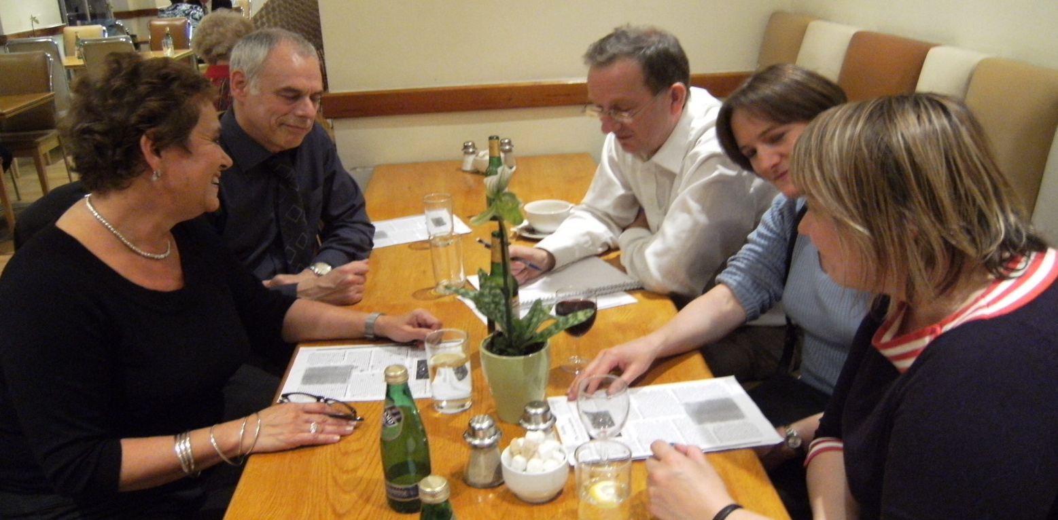
Science discussion groups
Look mum, no syllabus!

Slide 2
Points to discuss
What do you make of the observations?
Does it have anything to say beyond informal adult learning?

Slide 3
Origins of the scheme
Personal
  Lifelong curiosity about the world
  Sense of having ‘survived’ science education
Belief
  Ideas from science should be as accessible as from the arts
Observation
  Curiosity persisting despite poor education

Slide 4
Experience as teacher
not-physics envy
  Saw participative methods in other subjects
pastoral approach
  Handling emotional aspect of learning
theory
  Aware of Vygotsky’s and other’s ideas

Slide 5
Conceiving an alternative
Discussion format
  Start from questions/observations in everyday life
Ideas in science
  No maths, no labs
Doubts
  Would questions come and discussion flow?
  Could a single teacher handle the knowledge?
  Would it reach into science or be anecdotal?
  Would learning take place?

Slide 6
How it works
Dissipating negative feelings from school
Encouraging questions from experience
Exploring first thoughts on own terms
Identifying and introducing key concepts
Deciding to explain, defer or ‘Google’
Allowing discussion to develop as it will
Circulating summary afterwards
Visiting researchers on occasion

Slide 7

Listening in...
floating
colour

Slide 8
Observations
Immediate
  The process works
  It’s popular, especially with women
  Tutor role is altered
    No longer in command of factual knowledge
    Reflect back questions
    Identify underlying concepts in play
    Select and interpret sources
  Peer discussion motivates
  Not knowing is not a hindrance

Slide 9
Observations
Longer term
  Very wide range of topics
    Practical voltage in France (hair dryer)
    Mystifying radio transmission
    Quizzical antibiotics & viruses
    Worrying mental health, pain
    Existential universe, evolution
    Topical Large Hadron Collider, Ebola
  Pathways are unpredictable
    Tea – dissolving – molecular bonds

Slide 10
Observations
Discussion
  Cuts across disciplines
    Pigments – colour – TV – eye - brain
  Crosses conventional levels
    Primary (mass, volume and density)
    BSc (molecular orbital theory)
  Moves in and out of science, social science, humanities
    Drug action – receptors – cannabis - politics
  Little stepwise knowledge building

Slide 11
Implications
Non-scientists choose different curricula
Learning science rather than selling it
A more participative pedagogy is possible
  Engaging with life experiences
  Sustaining dialogue
  Focussing on actual concerns
  Allowing for self expression
  Focussing on understanding

Slide 12
Discussion points
It’s undoubtedly attractive for adults. But what does it amount to?
Gains
  Engages and motivates people who’ve dropped science
  Puts science on their intellectual map
  Stimulates understanding of fundamental concepts
Losses
  Little build-up of detailed knowledge on a topic
  Little sense of disciplines as wholes
  No experience of practical work or experimental method
  No insight into beauty or utility of maths

