Slide 1
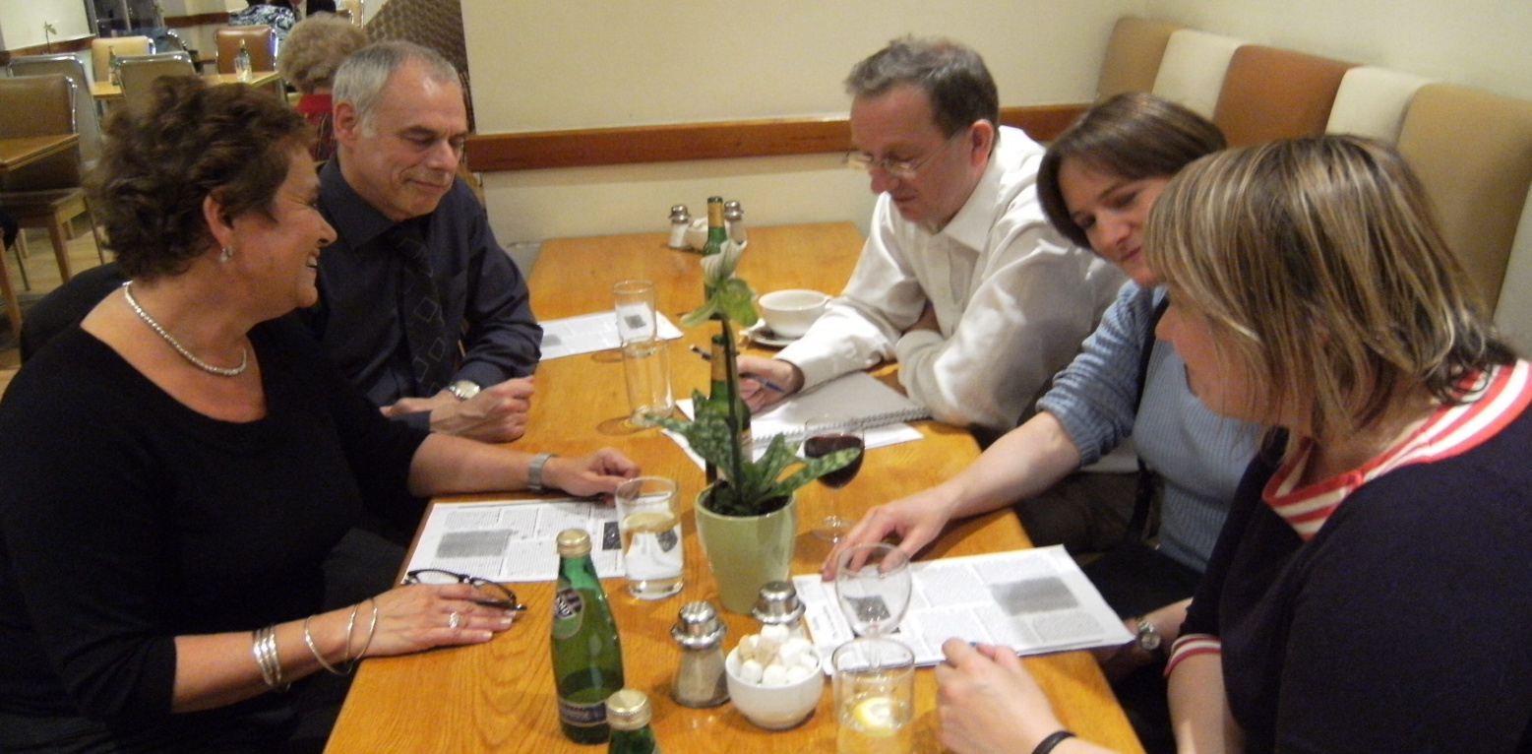
Science discussion groups
A case of public engagement?

Slide 2
Questions I’d like to discuss
The place of learning in engaging the public
Contrast with the place of informing, campaigning and marketing

Slide 3
Origins of the scheme
Lifelong curiosity about the world
Sense of having ‘survived’ science education
Curiosity persisting despite poor education
Ideas from science as for the arts

Slide 4
How it works
Dissipating negative feelings from school
Encouraging questions from experience
Exploring first thoughts on own terms
Identifying and introducing key concepts
Deciding to explain, defer or ‘google’
Allowing discussion to develop as it will
Circulating summary afterwards

Slide 5

Listening in...
floating
colour

Slide 6
Outcomes
Immediate observations
  The process works
  It’s popular, especially with women
  Tutor role is altered
  Not knowing is not a hindrance
Longer term observations
  Peer discussion motivates
  Pathways are unpredictable
  Discussion cuts across disciplines
  Little stepwise knowledge building

Slide 7
Implications
science-in-education differs from science
adults can assume authority over what is learned
a different pedagogy is possible
non-scientists choose different curricula

Slide 8
Modes of public engagement
Learning
Informing
Campaigning
Marketing

Slide 9
Discussion points
What is the balance of purposes in public engagement?
Should we be marketing science-in-education or changing it?
Is science the same for scientists and the general public?
Are there several different publics?

